Slide 1
Module 2.2 – Sensors and Actuators
Cameras, Motors, and Encoders

Slide 2
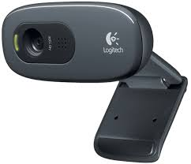
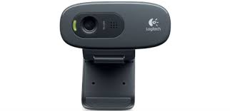
Cameras
Cameras provide high resolution sensing
Jet has a single camera providing a color image
Notes:
Cameras provide a low cost way to obtain high resolution sensing
The difficultly lies in processing the images captured by a camera
Jet has a single camera which provides a color image, but does not provide any depth information
The camera used on Jet is the Logitech C270 camera which provides a 1280x960 color image
In order to obtain depth image, one needs to use 2 cameras or a camera sensor that provides depth (an RGB-D camera)
The raw image from the camera can be obtain from a ROS topic

Slide 3
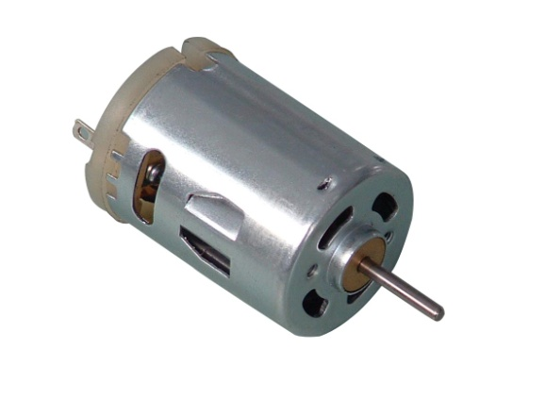
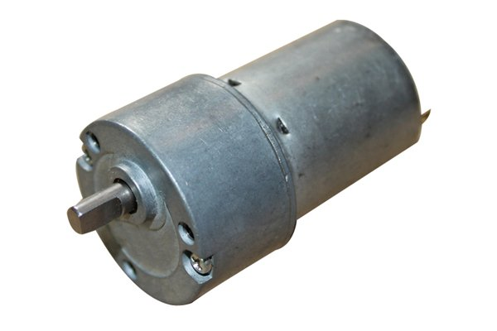
Motors
Motors convert electrical energy into mechanical energy (rotation)
Higher voltage increase motor speed and torque
The motors on Jet can take a range of input voltage from 2V to 12V
Higher voltage increase motor speed and torque
Notes:
Motor convert electrical energy which is applied from the battery and converts that into rotational mechanical energy
There are 2 motors on the JetBot, each drives one of the wheels
Motors can take a range of input voltages with higher voltages increase the rotational speed and the motor torque

Slide 4
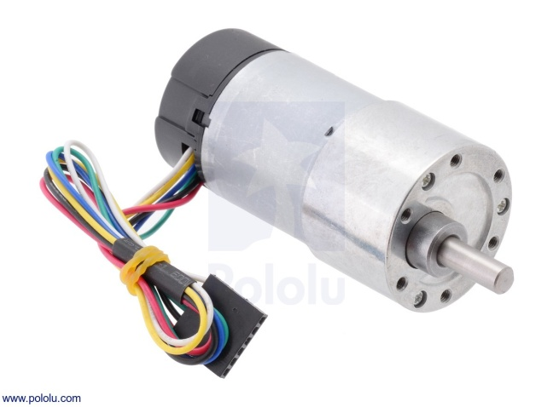
Motor Encoders
Encoders are used to measure the distance travelled by the robot
Jet has motors which can count up to 3200 ticks per revolution of the wheel
6-pin connector
These encoder values are published to ROS topics
Notes:
Encoders are sensors built-in to a motor that measure the amount a motor shaft has rotated
These measurements are expressed in ‘ticks’
The motors on Jet can measure 800, 1600, or 3200 ticks per revolution of the robot wheel
This gives very precise measurement on the distance travelled by the robot
These encoder readings can be obtained from ROS through topics

Slide 5
Motor Pinout
The Jet motors have a 6-pin connector
Motors need to be driven by an H-bridge
 | Red | Black | Green | Blue | Yellow | White
Description | Motor Power | Motor Power | Encoder Ground | Encoder Vcc (5V) | Encoder Output 1 | Encoder Output 2
Connect To | H-Bridge | H-Bridge | Ground | 5V From Arduino | Arduino Digital Input | Arduino Digital Input
Notes:
The motor connector on Jet is a 6-pin header
2 of the pins should be connected to the H-bridge (this is a board that is designed to drive motors)
There is a 5 volt encoder power pin and a ground pin
The Yellow and White pins should be connected to digital inputs on the Arduino to read the encoders

Slide 6
The GPU Teaching Kit is licensed by NVIDIA and California Polytechnic State University under the Creative Commons Attribution-NonCommercial 4.0 International License.

